Slide 1
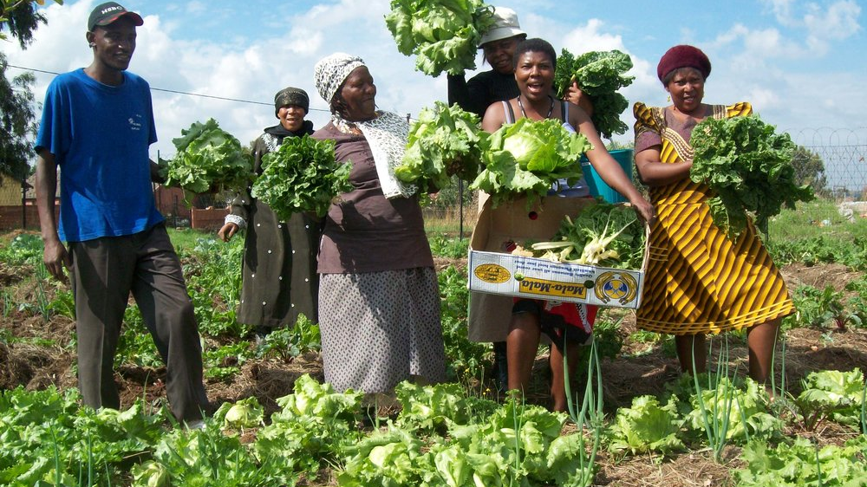
Grocom
The Future of Micro Farm Produce

Slide 2
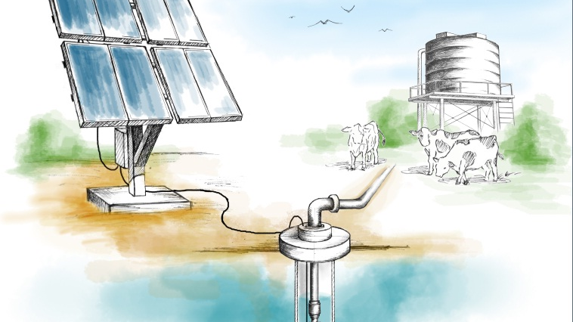
Sustainable Solar Powered Water Management (SPWM)
Grocom

Slide 3
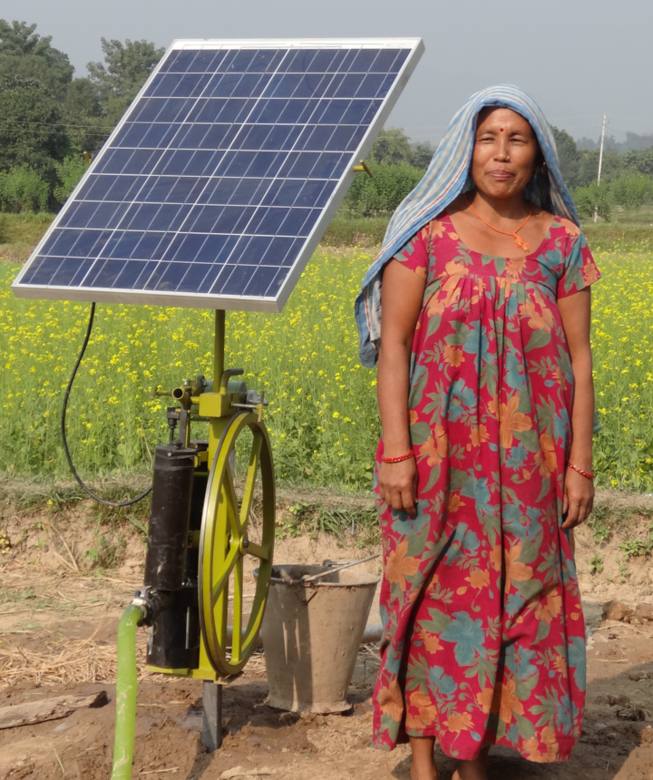

Potential of SPWMS in Sub-Saharan Africa:
Increase farmer yields by 70-300%
Impact 185 million lives
Generating USD 22 billion per year
Source: “Water for wealth and food security”, AG Water Solutions (funded by the Bill and Melinda Gates Foundation)
Notes:
Alternate pic?

Slide 4
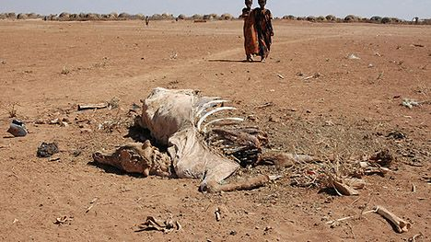
The Central Issue To Scalability
Upfront investment costs
2. Difficulty accessing information
3. Difficulty accessing inputs, such as seeds

Slide 5
The Grocom Process
1. Locate impoverished farmers who own land close to fresh water
2. Lease solar powered water management systems and provide necessary inputs
3. Educate farmers to increase yields and provide equipment maintenance

Slide 6
The Grocom Process
4. Buy produce directly from micro farmers at a fair market rate
5. Sell micro farm produce to the international market
6. Use profits to pay back equipment suppliers

Slide 7





The New Standard of CSR
Carbon Neutral
Certified Organic
Fair Trade
Saving Lives

Slide 8

Fruit with a story…
Thank you for buying my family’s fruit! We grew this fruit using the sun to power the leaves and to run our water pump. We hope you enjoy it as much as we have!
Please follow my micro farm on Instagram!
#TiwongesFarm # microFarmProduce

Slide 9

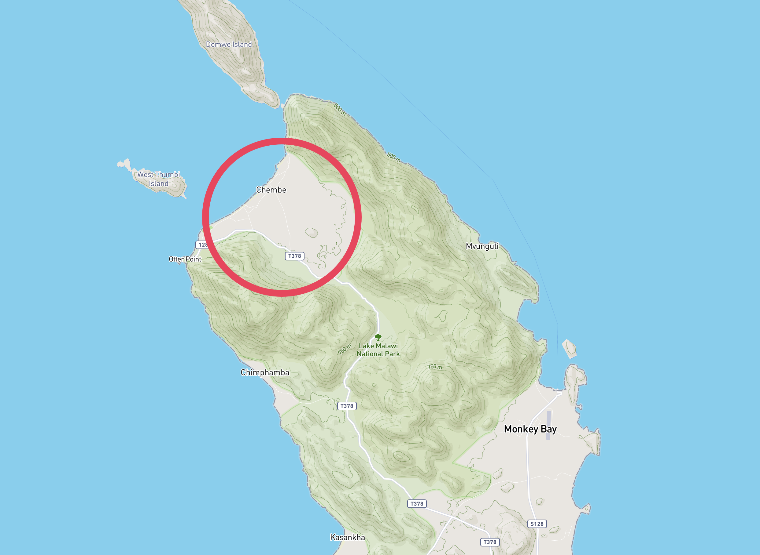
Pilot – Cape Maclear, Lake Malawi, Malawi
In partnership
with:
Currently farmers reliant on growing maize for 3 months to produce enough food for a year
3 hectare site approved for pilot
400 hectare site already offered if successful
Cape Maclear, Malawi
Notes:
Letter –Statement -> Where Text-Box is?
Grocom will work in partnership with Ulimi Irrigation to pilot the first site in Cape Maclear.

Slide 10
Hult Prize Team No. 20
Alessandra
Alexander
Rohan
Ty
Quote
Notes:
Hult Prize
Names
Quote
Ending

